Slide 1
IMS Project
By Adigwe (Adi) Uraih

Slide 2
Introduction
Name: Adigwe Uraih
How I approached the specification:
Created my risk log, Jira board and ERD
Once I was able to start the code, I wrote down all the relevant tasks that I needed to do
Planned how and when I should I complete individual tasks, while leave time for contingencies just in case the project was delayed

Slide 3
Consultant journey
Technologies learnt:
Git
Github
Jira
MySQL (Both MySQL Workbench and SQL on Google Cloud Platform)
Java Programming language
Eclipse
Maven
JUnit

Slide 4
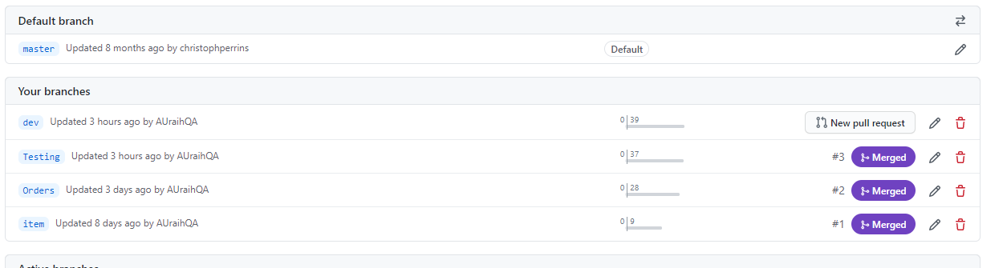
Version control
Branches:
Master
Dev
Orders
Item
Testing
The branches where I worked on the features were Items, Orders and Testing.

Slide 5
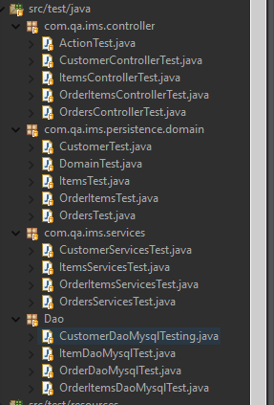
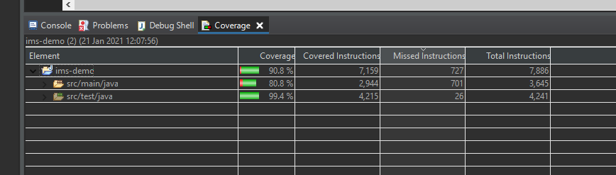
Testing

Slide 6
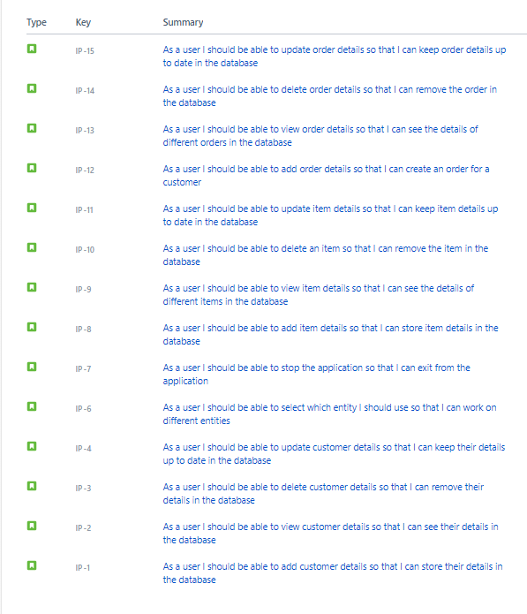
User stories

Slide 7
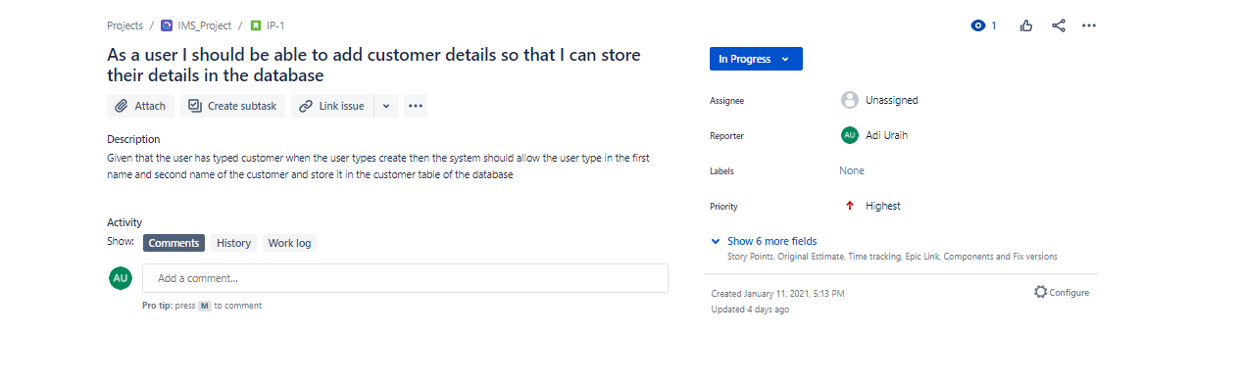
Example of acceptance criteria

Slide 8
SPRINT REVIEW
I was able to complete each user story that
No user story was left out in order to complete CRUD
All must have user stories were completed

Slide 9
SPRINT RETROSPECTIVE
What went well?
All user stories were completed
80% of code was covered
What could be improved?
Time left to put everything together
Amount of time given from when I started the project
Not having all user stories as must haves

Slide 10
Conclusion
Expanded my knowledge on a wide range of technologies
Was able to know where I am at regarding what has been taught
Now know that tasks take longer than expected
Give more time certain tasks such as testing
Adding more risks to risk log

